Slide 1
CMP203 Graphics Programming
Transforms and Hierarchical Modelling

Slide 2
This week
Matrices in 3D graphics
What is ModelView
Transforms
Delta time
Hierarchical transforms

Slide 3
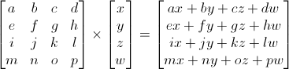
Matrices
Array of scalar values storing a system of coefficients that describe a linear transformation
Transformations of Scaling, Rotation and Translation, or any combination of all three can be described
You will have covered these in more detail in other modules
You won’t be interacting with these directly, but these control EVERYTHING

Slide 4
Matrices in 3D graphics
Matrices are all important in 3D graphics
Much of what you do is done by manipulating matrices
Each part of the pipeline can greatly effect the outcome and is controlled by matrices
3D pipeline:
Modelling > Viewing > Projection > Display

Slide 5
Model matrix
Modelling
Process of building the 3D scene
Objects are specified in a local Coordinate system
To move the object to its proper location we must apply a transform to it
If we want to move the object (Frame by frame) we update the matrix (f by f)

Slide 6
Model matrix
Transforms govern almost everything in the game world
Manipulating objects vertex by vertex is rarely used for anything other than animation
We apply the matrix transformation prior to rendering the shape
The updated matrix modifies how the shape is rendered

Slide 7
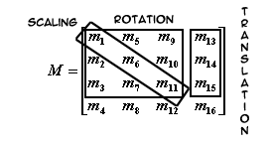
Modelling matrix
Matrices we use for Graphics programming are 4*4
OpenGL uses Column Major Matrices!

Slide 8
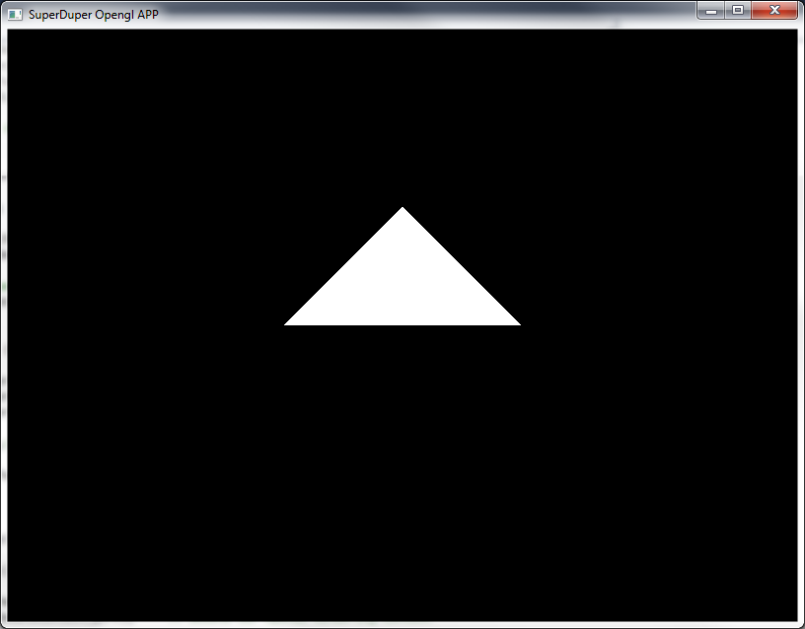
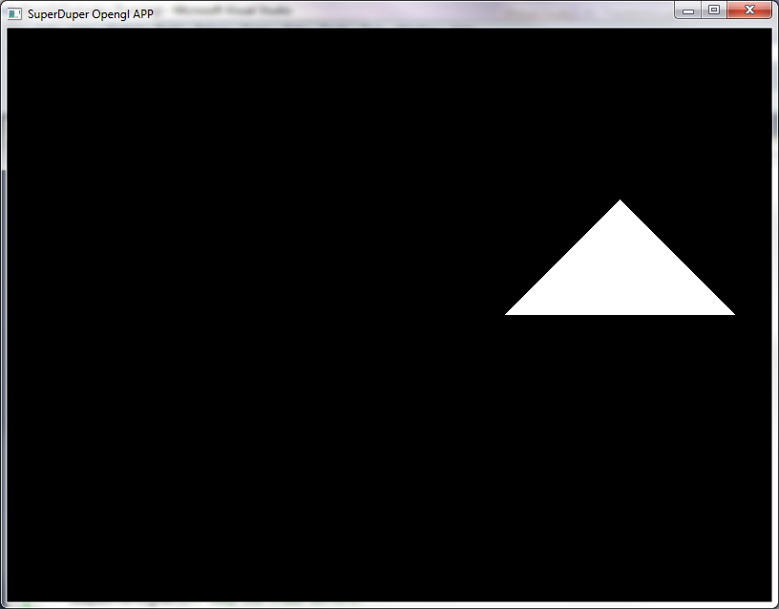
Translate
glTranslatef(x, y, z);
glTranslatef(2, 0, 0);
Moves the object in 3D space

Slide 9
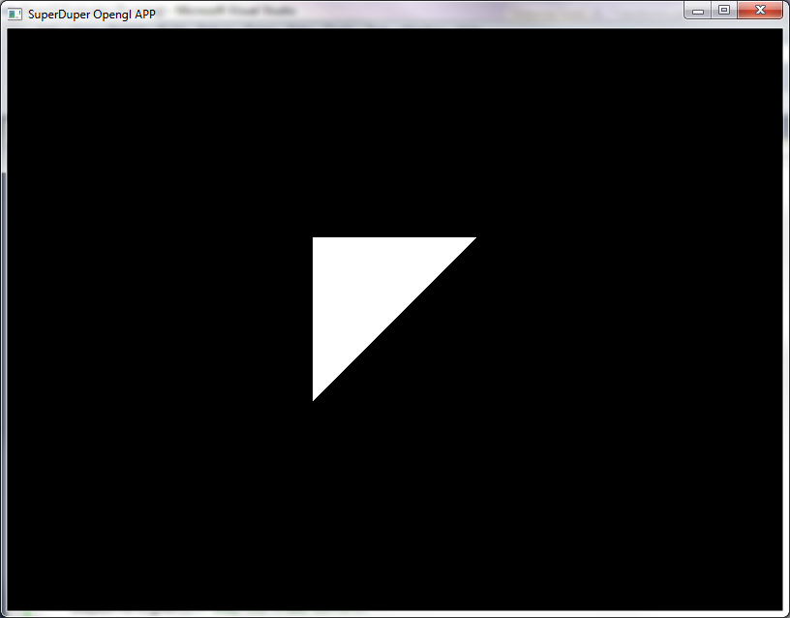
Rotate
glRotatef(degrees, x, y, z);
glRotatef(45, 0, 0, 1);
Rotates the object around the specified vector

Slide 10
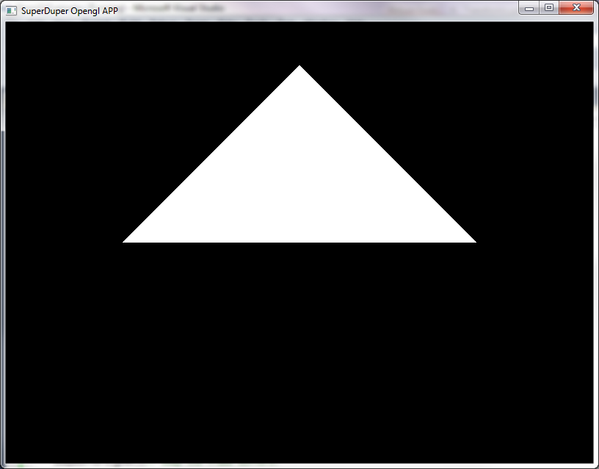
Scale
glScalef(x, y, z);
glScalef(2, 2, 2);
Scales the object some amount in each axis

Slide 11
How does that look in code?
glLoadIdentity(); // load Identity Matrix
gluLookAt(0, 0, 6, 0, 0, 0, 0, 1, 0);
rotation += speed * dt; // should really be done in update();
glRotatef(rotation, 0 ,1 , 0); // must be done before drawing
glBegin (GL_TRIANGLES); //Begin drawing state
glVertex3f( 0.0, 1.0, 0.0);
glVertex3f(-1.0, 0.0, 0.0);
glVertex3f( 1.0, 0.0, 0.0);
glEnd(); //end drawing

Slide 12

Rotation around Y-axis

Slide 13
Rotation around Z-axis

Slide 14
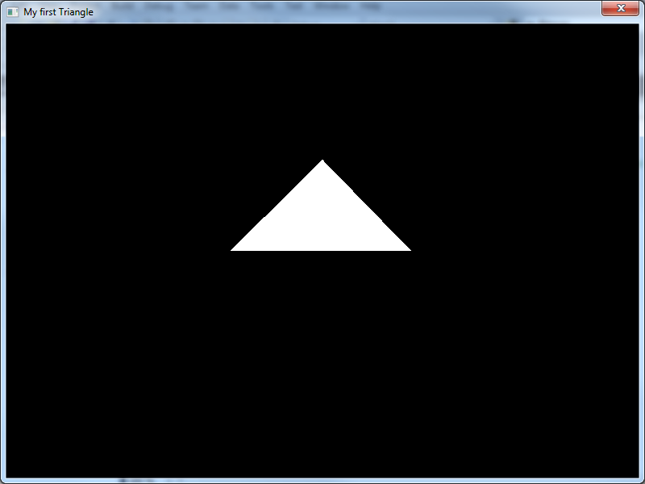

Slide 15
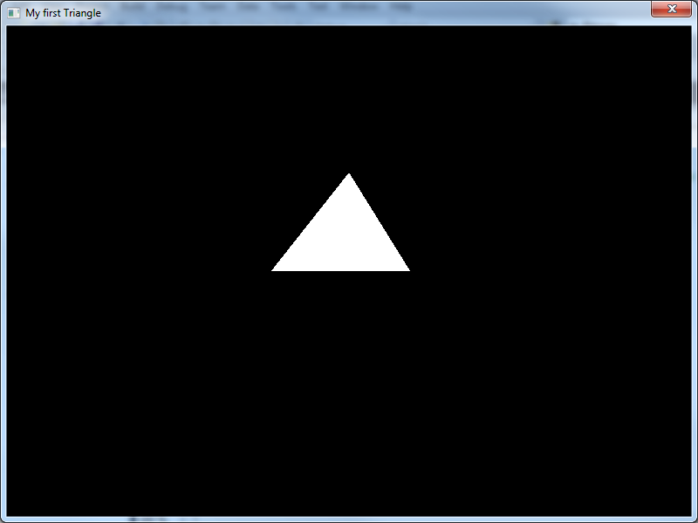

Slide 16
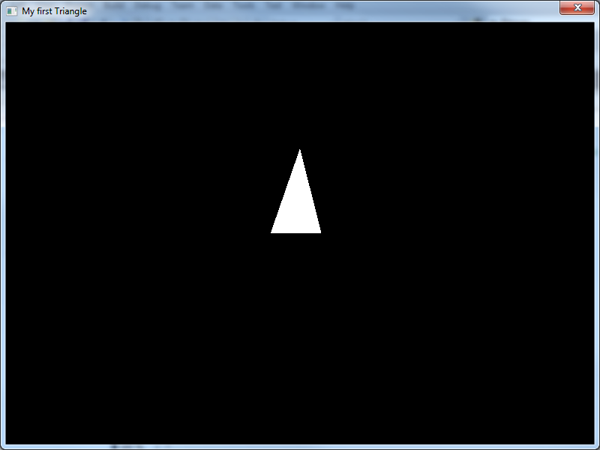

Slide 17
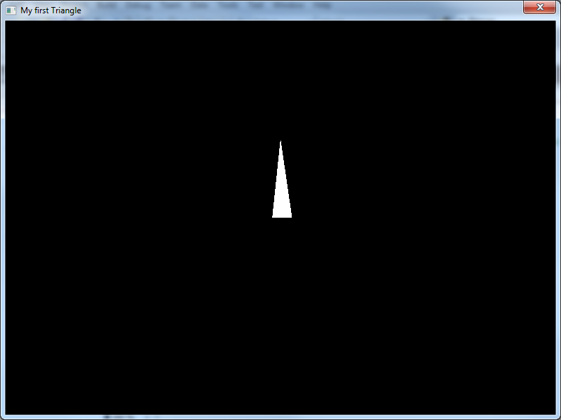

Slide 18
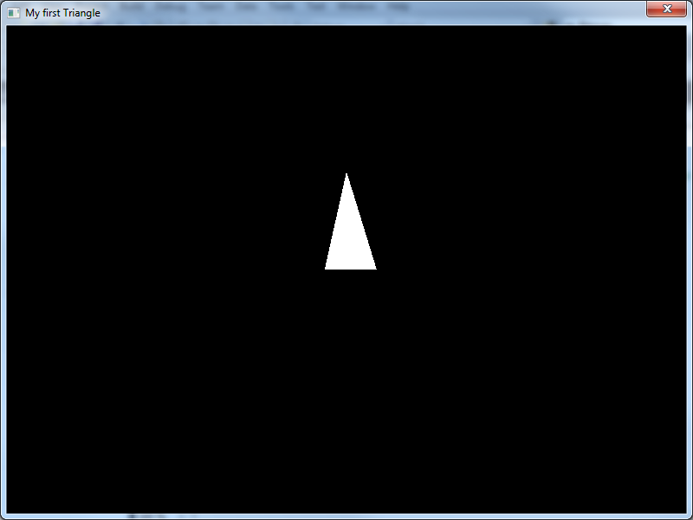

Slide 19
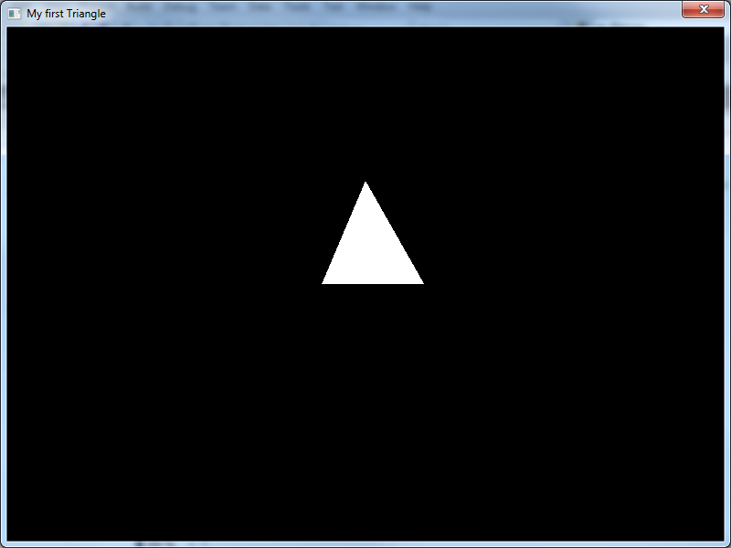

Slide 20


Slide 21
Order is IMPORTANT!
What if we want to do more than one transformation
For example, to have a triangle rotating in its own local axis away from the origin
Transform order is important!
glTranslatef( 1.0, 0.0, 0.0 );
glRotatef(rotation, 0 ,1 ,0);
Is not the same as
glRotatef(rotation, 0 ,1 ,0);
glTranslatef( 1.0, 0.0, 0.0 );

Slide 22

Guess
If we
glTranslatef( 2.0, 0.0, 0.0 );
glRotatef(90, 0 ,0 ,1);
drawTriangle()
What happens to the triangle?

Slide 23
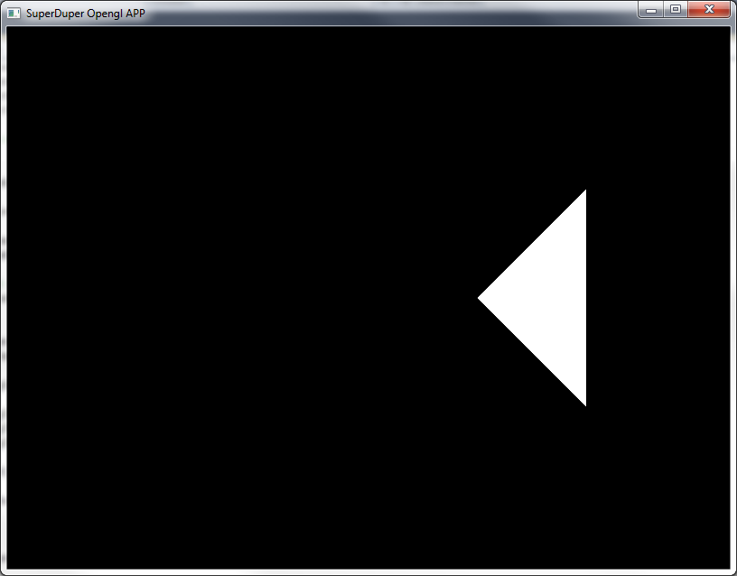
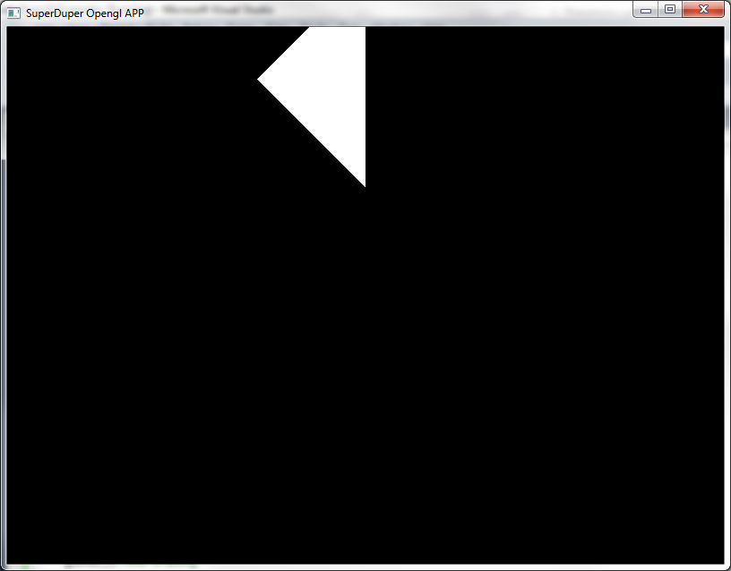
What happens?

Slide 24
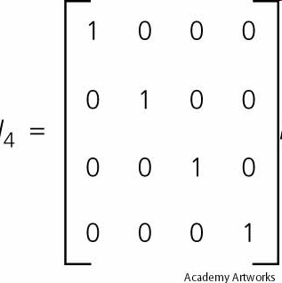
The identity matrix
glLoadIdentity();
Resets the current matrix back to the Identity / default matrix
Be aware that if it is used you will need to re-apply the camera transform

Slide 25
Modelling and Viewing Transforms
View Transform
gluLookAt(0, 0, 6, 0, 0, 0, 0, 1, 0);
First Transform we apply after setting the identity
Sets position and direction of the “camera”
As a default, it points down the z-axis
OpenGL combines this transform with our model transform at the view stage of the pipeline
This defines how the scene is seen

Slide 26
Delta time

Slide 27
The problem
Controlling animation, movement etc
Moving an object every frame can be unpredictable
Not all hardware is created equally
Some computers will generate more frames in the same amount of time
Moving 1 pixel every frame would be find if everything was 60FPS
But if it runs at 30 FPS our game is now at half speed
Or twice speed at 120 FPS

Slide 28
Delta time
The time interval between frames
Not constant, has random variation
Its use can ensure that movement/animation/etc are consistent
Not dependent on system performance
To do movement
Speed = change in distance over time (per second)
Delta = Time between frames
Movement = speed * delta
Careful of the unit of measure second vs millisecond

Slide 29
Some maths
A rough example
Desired speed is 100 pixel per second
We manage 50 frames per second
If delta was constant it would be 1/50
0.02 seconds
So for every frame we want to move
100 pixels * 0.02 seconds = 2 pixels per frame (ish)

Slide 30
Some maths
Now the frame rate changes to 5 FPS
As each frame takes longer to calc, delta time increases
The distance an object moves per frame changes
At 5 FPS the object moves 20 pixels to keep up
Frame rate independence

Slide 31
Hierarchical Transforms

Slide 32
Transforms in Games
Typically in games
A scene comprises of many objects each requiring transforms to place and orient it
With our Current system, we are manipulating a single “Current” matrix
So what happens when we want to manipulate two or more objects in a complex way?
The only way to wipe the matrix clean is to Load the identity matrix then redo the view transform
Not practical and not elegant

Slide 33
The Matrix Stack
The Matrix stack is a list of Matrices that we can manipulate, built into OpenGL
Helps us organise our models transforms into a hierarchy. Allowing much more complex manipulation of objects.
Already been using the matrix stack! But only the top level.
Allows us to ‘Save’ the current matrix transform we are using to the stack
This works for the modelling, projection and texturing transforms.

Slide 34
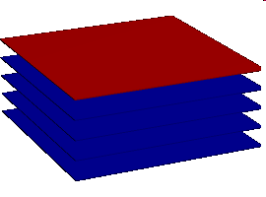
The Matrix Stack
LIFO stack system (A reminder)
Stack of data objects. In our case matrices.
Up to 32 Matrices (4*4) can be stored.
The last data to be added to the stack is the first taken out.
Only two commands to manipulate the stack.
Push (puts a new data value on top of the stack).
Pop (removes top value from the stack).

Slide 35
The Matrix Stack
Implementation in OpenGL
The ‘top’ of the matrix stack, is the one we have already been using. This is the current matrix that we change. This is the transform that is applied to whatever we draw next.
glPushMatrix()- moves the matrix stack down 1 entry. Copies the current matrix into the second entry. (Top and second from top matrices are now the same)
glPopMatrix()- Deletes the current (top matrix) The second from top is the new current matrix.

Slide 36
The Matrix Stack
Think of it more as
Push – “remember where we are”
Pop – “ Go back to where we were a second ago”
Note that when you Pop back to the previous matrix, this is the current matrix and no longer stored in the stack.
If you want to go back to a certain transform again. The first thing you do after you pop is push it to the stack again.
Endless fun!

Slide 37
Hierarchical Modelling
Using the Matrix stack to store previous matrix transforms so we can place multiple objects in complex ways
For example an object used multiple times in a single scene, each time requiring a new transform
Warehouse full of crates
Multiple AI enemies of a single type
A car

Slide 38

Hierarchical Modelling
An Example: Drawing a car
Car has 4 wheels
Each wheel has 4 bolts
We can use the matrix stack to draw a car with 4 wheels, only using a single “Draw wheel function”

Slide 39
Hierarchical Modelling
Draw Wheel Function
Draw Wheel()
for(i=0, i<5, i++)
{
glPushMatrix();
glRotatef(72.0*i, 0.0, 0.0, 1.0)
glTranslatef(3.0, 0.0, 0.0);
draw bolt()
glPopMatrix()
}

Slide 40
Hierarchical Modelling
Draw car and all wheels
Draw car body();
glPushMatrix();
glTranslatef(40, 0, 30); first wheel position
Draw wheel and bolts();
glPopMatrix();
glPushMatrix()
glTranslatef(40, 0, -30); second wheel position
Draw wheel and bolts();
glPopMatrix()
etc

Slide 41
Hierarchical Modelling
What's really happening
Transform out to where you want the car to be.
Draw the car body.
Remember where you are.
Translate out to the first wheel position.
Remember where you are.
Draw each bolt on the wheel.
Go back a transform.
Go back another transform. (now we are back to the car position)
Remember where you are.
Translate out to the second wheel position
etc

Slide 42
Hierarchical Animation
What happens when we alter the transform that we used to place the car?
The whole car moves! Wheels, bolts and all!
You can even spin the wheels on the car and the bolts will move accordingly!
Changing a transform higher in the hierarchy will cause everything below that to be altered!

Slide 43
Hierarchical Animation
Our Car hierarchy:
Identity/View (pushed)
Translate/Rotate for Car (Pushed)
Translate for wheel
Changing the Translate/Rotate for the car effects the translations below it since they are created relative to the cars transformation

Slide 44
Hierarchical Animation
Animation in games falls into two distinct types
Pre-Generated
Key-framed
Loaded animation sequences
Procedural
Algorithmically controlled
Hierarchical animation

Slide 45
Hierarchical Animation
Examples
Solar system
Planets Orbiting sun
Planets have Axial tilt, their own moons etc.

Slide 46
My solar system (not yours)
A sun, two planets and a (that’s no) moon
The two planets orbit the sun
The moon orbits the second planet
(and because that planet orbits the sun, technically so does the moon)
Planets are positioned in relation to the sun, if we move the sun all the planets (and moons) will move with it
How do we do this?
Notes:
I’m cheating and using a function to draw spheres
We will look into doing this ourselves eventually
Focus on the hierarchical modelling aspect for now

Slide 47
Draw scene
void Scene::render() {
// Clear Color and Depth Buffers
glClear(GL_COLOR_BUFFER_BIT | GL_DEPTH_BUFFER_BIT);
// Reset transformations
glLoadIdentity();
// Set the camera
gluLookAt(0.0f, 0.0f, 4.0f, 0.0f, 0.0f, 0.0f, 0.0f, 1.0f, 0.0f);
// Render geometry here -------------------------------------
// rotate matrix
glTranslatef(-1.0f, 0.0f, 0.0f);
//tilt our solar system slightly so it isn’t on the eye plane
glRotatef(20, 1, 0, 0);
glPushMatrix();// Remember where we are. THE SUN

Slide 48
Draw scene
// render the sun
glColor3f(1.0f, 0.9f, 0.0f);
gluSphere(gluNewQuadric(), 0.20, 20, 20);
glPushMatrix();
//render planet 1
glRotatef(rotation, 0, 1, 0);
glTranslatef(1, 0, 0);
glScalef(0.1, 0.1, 0.1);
glColor3f(0.8f, 0.1f, 0.1f);
gluSphere(gluNewQuadric(), 0.20, 20, 20);
glPopMatrix();//GO BACK TO SUN
// Notice the indentation, this helps keep track of all the pushes and pops

Slide 49
Draw scene
glPushMatrix(); // REMEMBER WHERE WE ARE
// render planet 2
glRotatef(rotation2, 0, 1, 0);
glTranslatef(1.5, 0, 0);
glScalef(0.3, 0.3, 0.3);
glColor3f(0.1f, 0.9f, 1.0f);
gluSphere(gluNewQuadric(), 0.20, 20, 20);
glPushMatrix(); // REMEMBER WHERE WE ARE
// Render a moon around planet 2
glRotatef((rotation2*2.0), 0, 1, 0);
glTranslatef(1.5, 0, 0);
glScalef(0.3, 0.3, 0.3);
glColor3f(0.8f, 0.8f, 0.8f);
gluSphere(gluNewQuadric(), 0.20, 20, 20);
glPopMatrix();
glPopMatrix();//GO BACK TO SUN
glPopMatrix();

Slide 50
Draw scene
// reset colour
glColor3f(1.0f, 1.0f, 1.0f);
// Geometry rendering ends here -----------------------------
// Render text, should be last object rendered.
renderTextOutput();
// Swap buffers, after all objects are rendered.
glutSwapBuffers();
}

Slide 51
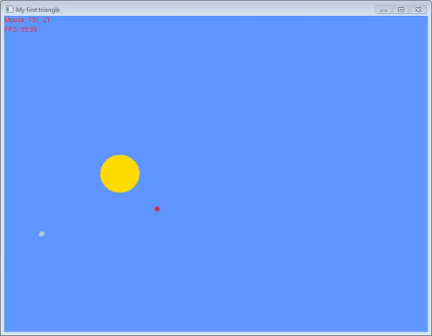
Result

Slide 52
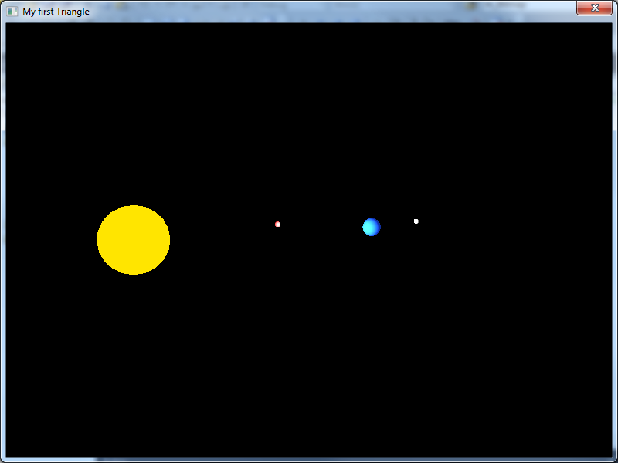

Slide 53
Update every frame
We need to increase the rotation variables every frame
void Scene::update(float dt)
{
// Handle user input
// Update object and variables (camera, rotation, etc).
rotation += speed * dt;
rotation2 += (speed * 2) * dt;
// Calculate FPS
frame++;
time = glutGet(GLUT_ELAPSED_TIME);
if (time - timebase > 1000) {
sprintf_s(fps, "FPS: %4.2f", frame*1000.0 / (time - timebase));
timebase = time;
frame = 0;
}
}

Slide 54
Hierarchical Animation
Further use
Skeletal animation
Rag doll Physics
Inverse Kinematics

Slide 55
Summary
Lab Tutorial
Using the different transforms
Use keyboard controls to rotate objects
Make a cube
Hierarchical modelling (working with the solar system)
Suggested project layout
Copy the GraphicsProgramming project (each week)
Keeps working code from labs as example
Help when doing coursework
For most labs you can create a lab2() etc to contain most of the lab code
Keeps things tidy, don’t end up with large sections of commented out code (that probably won’t work)
Saves on space a little

Slide 56
C++ tutorials
http://www.cprogramming.com/tutorial/c++-tutorial.html
http://www.cplusplus.com/doc/tutorial/
http://www.learncpp.com/

